Slide 1


Join at slido.com #3436682
ⓘ Start presenting to display the joining instructions on this slide.

Slide 2

Clearing the Air: Unveiling Insights on Health Through Data Analysis

Slide 3
THE Process
Data and PRocess

Slide 4
OpenWeatherMap Air Pollution API
Global Health Data Exchange
Australian Bureau of Statistics (2021) Regional Population
API NINJAS
Etc.
Study Objective:
Analyse key air pollution metrics at varying scales and over different timeframes to evaluate impact on public health and wellbeing.
Collation
Cleaning
2
Data Preparation
Descriptive Stats
1
Define
3
Exploratory Data Analysis
Graphical Stats
Input: Hypothesis
6
Review &
Feedback
4
Interpretation & Validation
5
Conclusions
Output: Reporting

Slide 5
LET’s HAVE SOME FUN
HYPOTHESES Q&A

Slide 6
Population question at global scale
Population question at the local scale – Australia
Seasonal question – Global
Pollutant v mental health correlation – Global
Pollutant v respiratory health challenges - Global

Slide 7

The greater the population size, the higher the recorded pollution in a town or city.
ⓘ Start presenting to display the poll results on this slide.
Notes:
Alvin

Slide 8
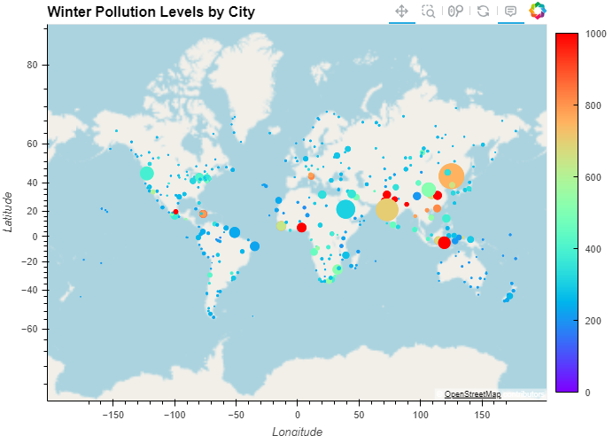
Global Winter CO Pollution Levels by Population (bubble size)
CO (μg/m³)
Correlation data
Notes:
Alvin

Slide 9
Higher population densities are associated with higher air pollution levels in Australian towns and cities.
ⓘ Start presenting to display the poll results on this slide.
Notes:
Alvin

Slide 10
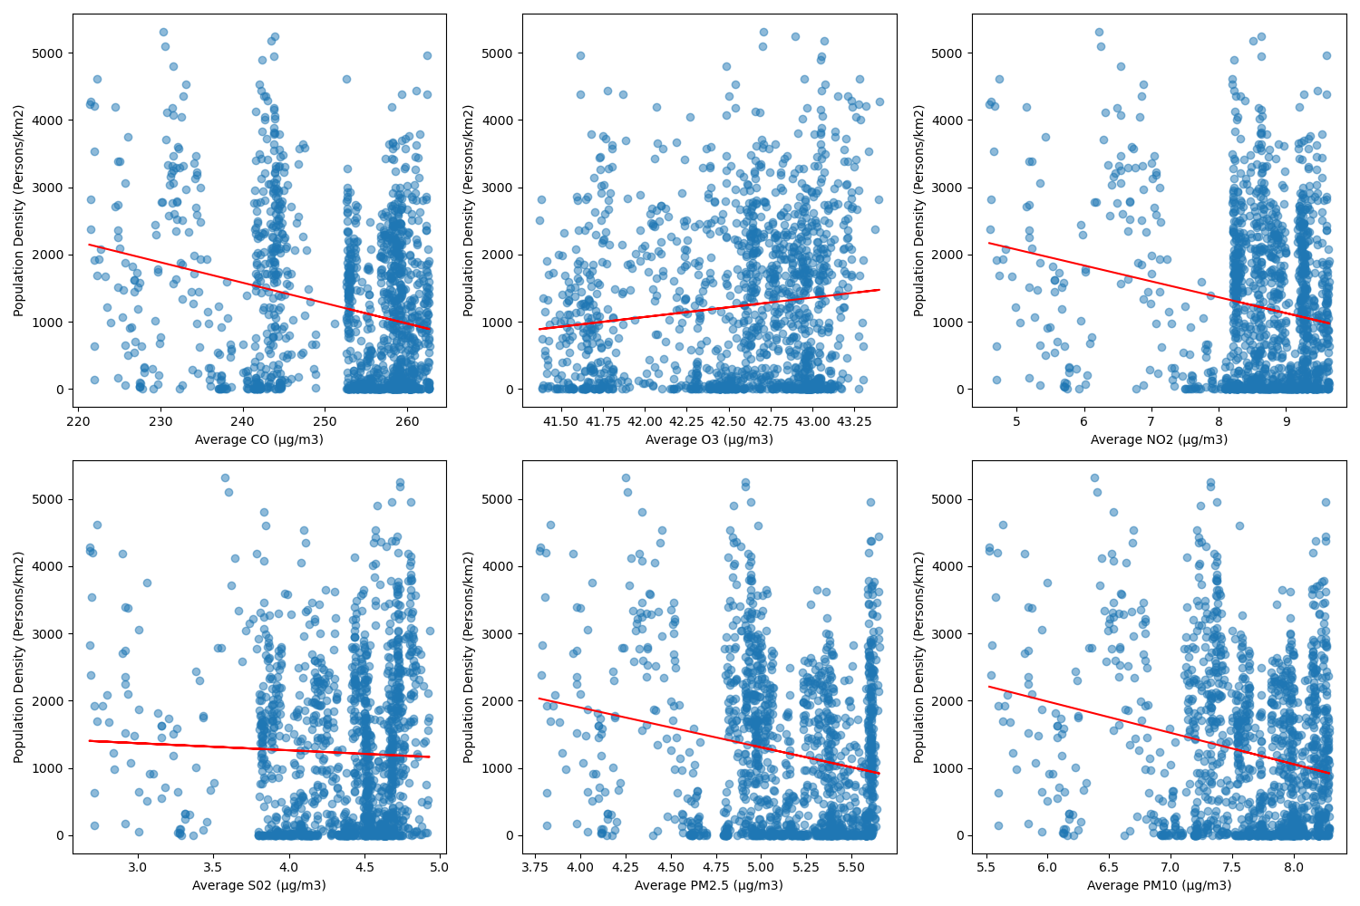
Notes:
Alvin

Slide 11
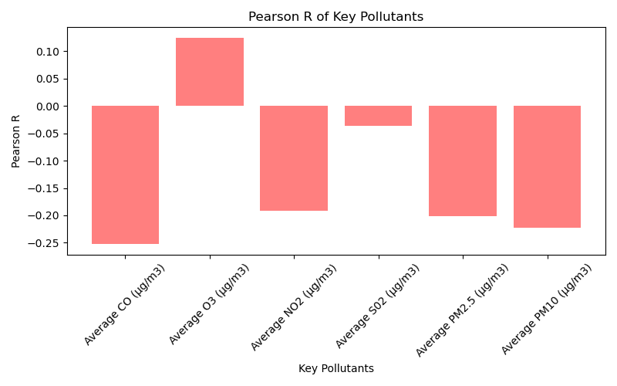
Notes:
Alvin

Slide 12
Lower population density: fewer sources of pollution per square km
Stringent environmental regulations: help to reduce emissions of air pollutants and improve air quality.
Geographic factors: Vast open spaces, prevailing winds, rainforest etc.
Low levels of industrial activity: fewer industrial sources of pollution
Notes:
Alvin

Slide 13
Pollutant levels vary significantly across the four season.
ⓘ Start presenting to display the poll results on this slide.

Slide 14
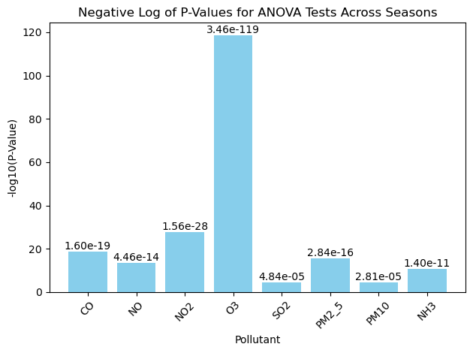

Slide 15
Higher levels of air pollutants correlate with higher occurrences of depressive disorders.
ⓘ Start presenting to display the poll results on this slide.

Slide 16
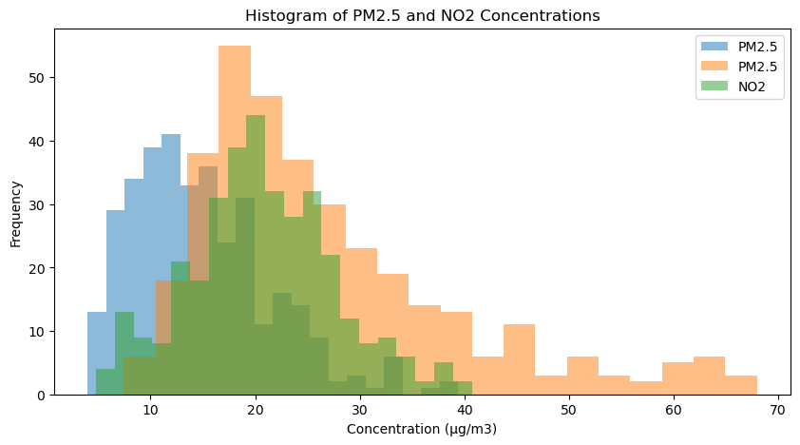

Slide 17
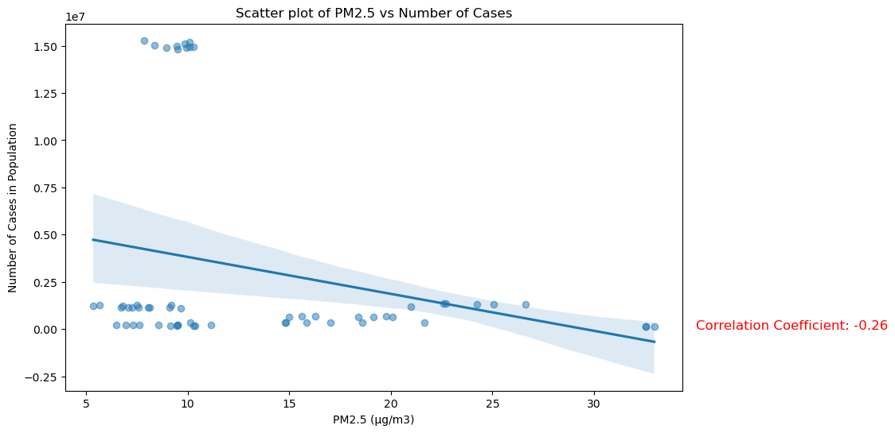

Slide 18
There are higher occurrences of respiratory disorders in towns and cities with higher levels of pollution.
ⓘ Start presenting to display the poll results on this slide.

Slide 20
CONCLUSIONS
SO WHAT ARE OUR THOUGHTS

Slide 22

THANK YOU

